Slide 1


Bismillahir Rahmanir Rahim
SMART HOME AUTOMATION
A Smart Home System Featuring Password Based Door Lock & Google Assistant Voice Control Integration
-Presented by
Sanzida Nishat Nishi (C231442)
Saima Binte Soyeb (C231449)
Kazi Namira Meyheg Sanam (C231450)
Umme Benin Yeasmin Meem (C231452)

Slide 2

1
INTRODUCTION
In today’s digital age, smart home technology boosts comfort, security, and energy efficiency. This project develops a smart automation system using Arduino UNO. It features a password-protected door lock and voice-controlled appliances for an affordable, modern solution.
IIUC | 2025

Slide 3
2
OBJECTIVE
CORE OBJECTIVE
KEY OBJECTIVE
Build a low-cost smart home system.
Ensure security with password door lock.
Enable voice control for appliances.
Secure door with Password-lock.
Control device via voice commands.
Expandable and simple.
IIUC | 2025

Slide 4
3
FEATURES
Password-protected door lock with keypad
Voice control via Google Assistant
- Bluetooth communication (HC-05)
- Relay-based appliance control
Arduino UNO as central controller
Easy to upgrade and low cost
IIUC | 2025

Slide 5
4
SYSTEM ARCHITECHTURE
Central Unit: Arduino UNO
Access Control: 4x4 Keypad + Servo Motor
Voice Commands: Google Assistant → IFTTT → Bluetooth (HC-05)
Appliance Control: Relay Module (Light/Fan)
IIUC | 2025

Slide 6
5
FLOW CHART
Start
Enter Password
Correct
End
YES
NO
Relay – Control Appliance (Light/Fan)
Unlock Door – Auto relock
Access Denied
Voice Command
(e.g.,“Turn on light”)
Arduino UNO Interprets Signal
Google Assistant / IFTTT
Bluetooth Module (HC-05)
IIUC | 2025

Slide 7
6
HARDWARE COMPONENTS
Arduino UNO – Microcontroller
4x4 Keypad – Password input
SG90 Servo Motor – Lock mechanism
HC-05 Module – Bluetooth communication
Relay Module – Switch appliances
Power Supply – 5V DC
IIUC | 2025

Slide 8
7
SOFTWARE COMPONENTS
Arduino IDE – Code development & upload
IFTTT / Bluetooth Terminal App – Voice to signal conversion
Google Assistant – Voice interface
IIUC | 2025

Slide 9
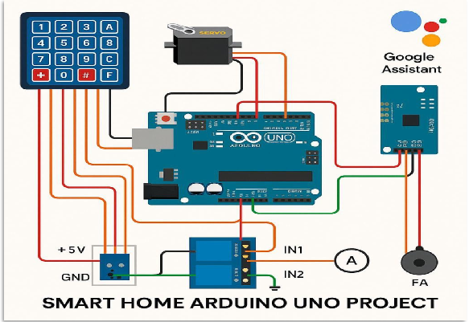
8
CIRCUIT DIAGRAM
IIUC | 2025

Slide 10
9
WORKING PRINCIPLE
🔑 Password Door Lock
Enter correct code → Servo unlocks
Auto relocks after delay
Wrong code → Access denied
🗣 Voice-Controlled Appliances
Commands like “Light ON” → Bluetooth signal
Arduino triggers relays accordingly
IIUC | 2025

Slide 11
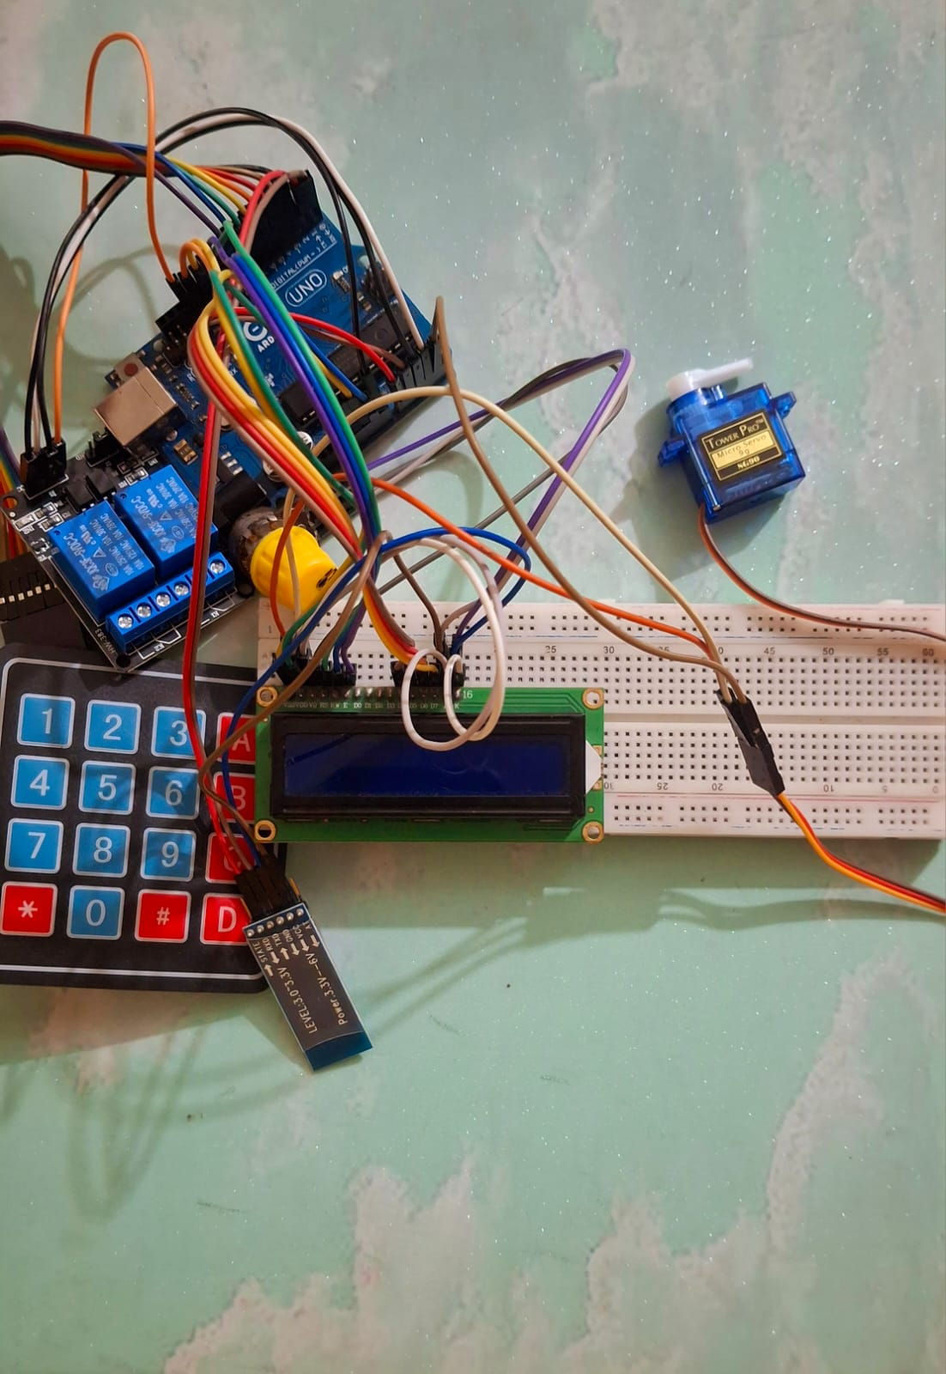
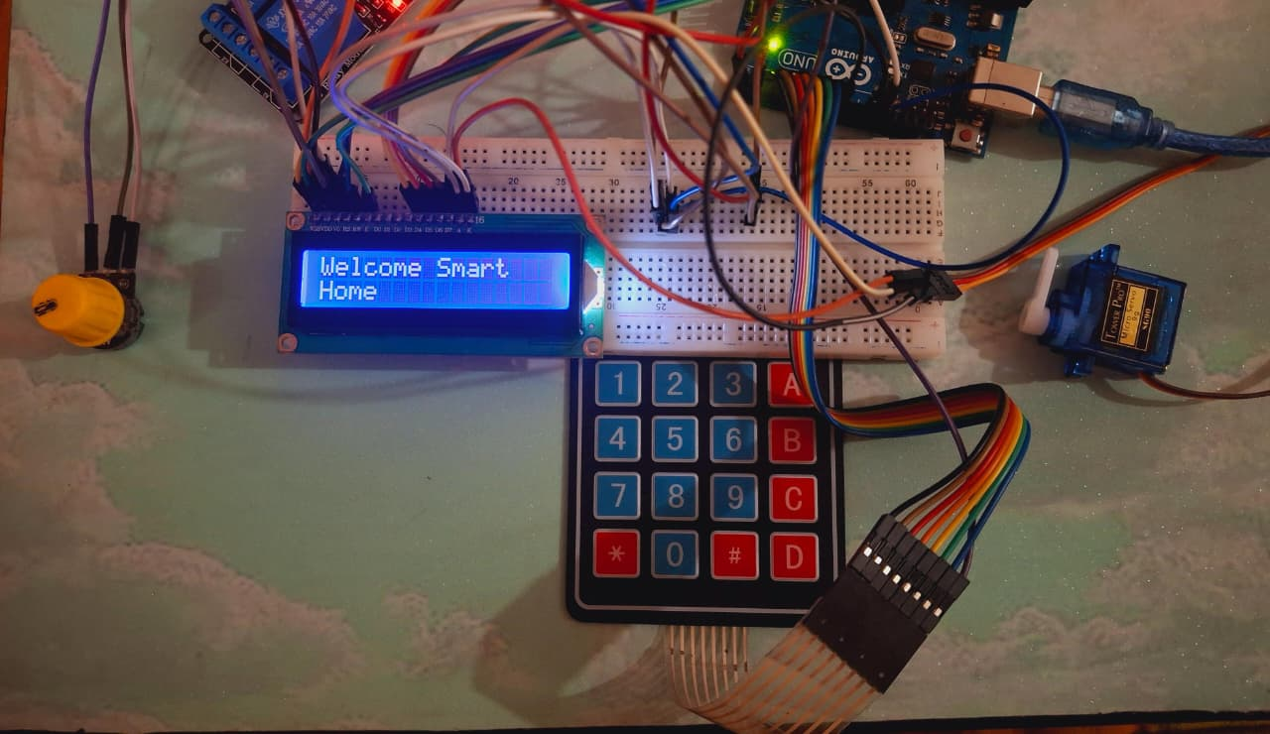
10
PROJECT PREVIWE
Fig C1: Overall connection of our project
Fig C2 : The project will be activated and show the “Welcome Smart Home” message
IIUC | 2025

Slide 12
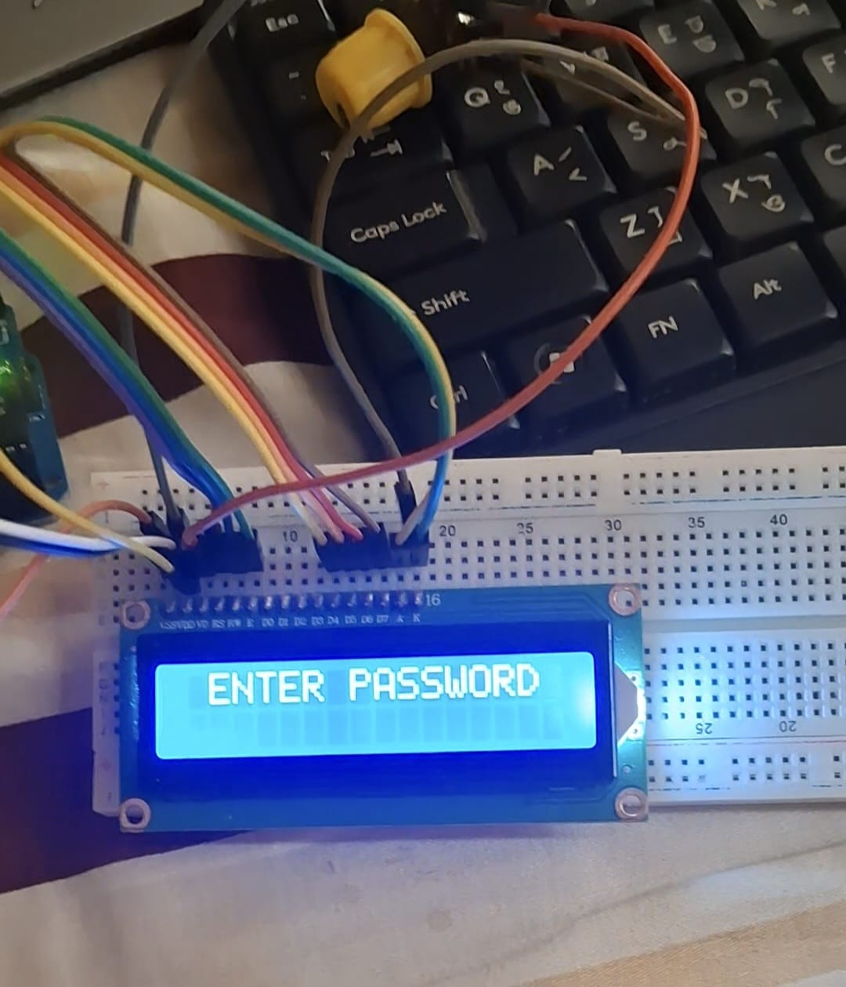
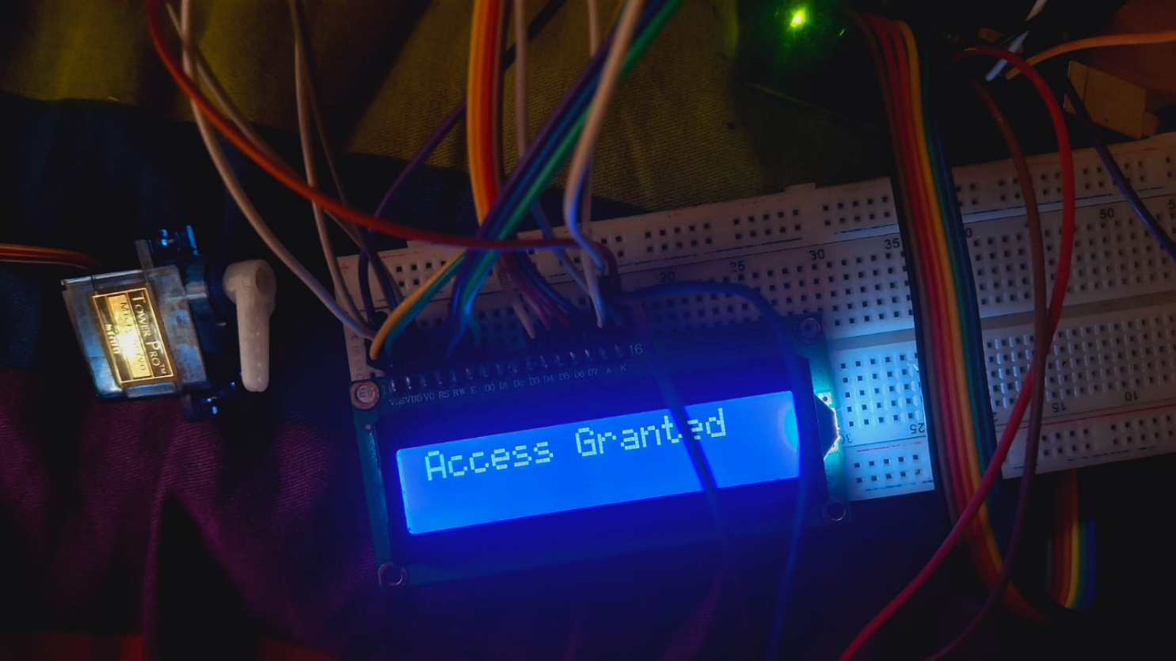
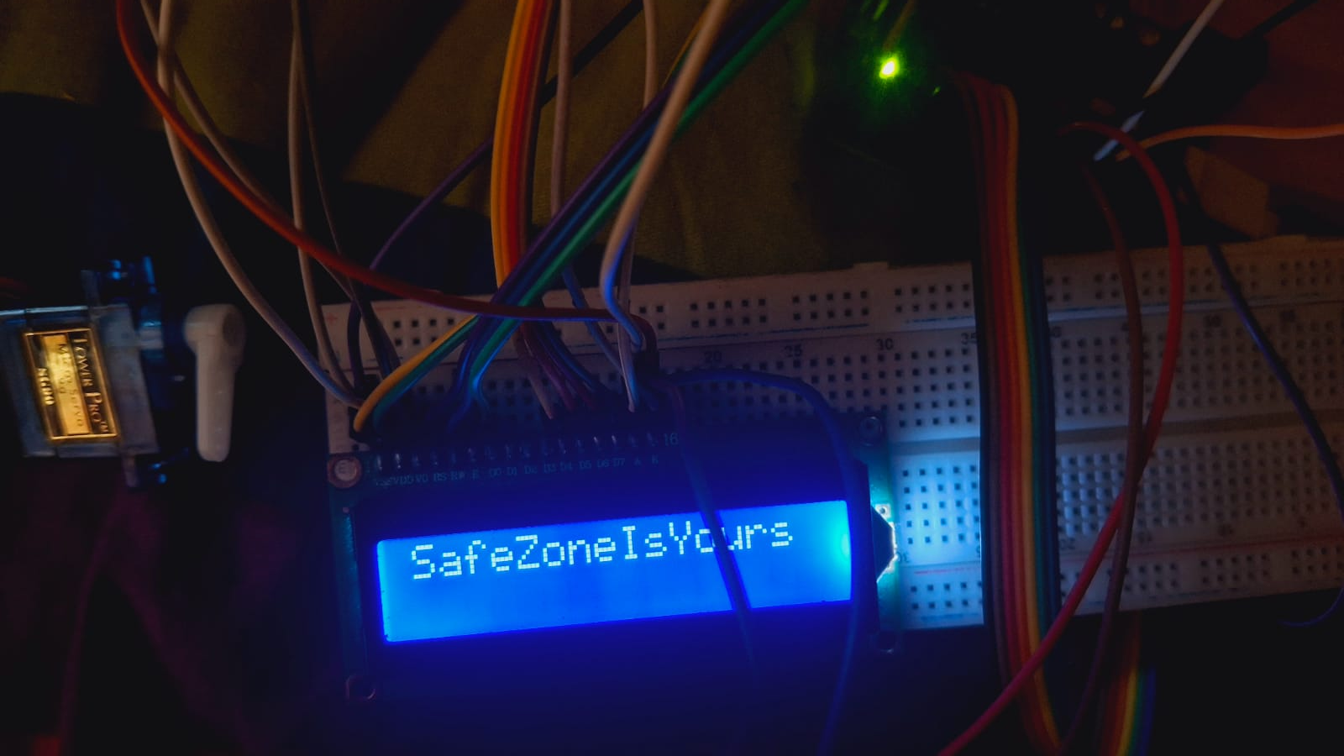
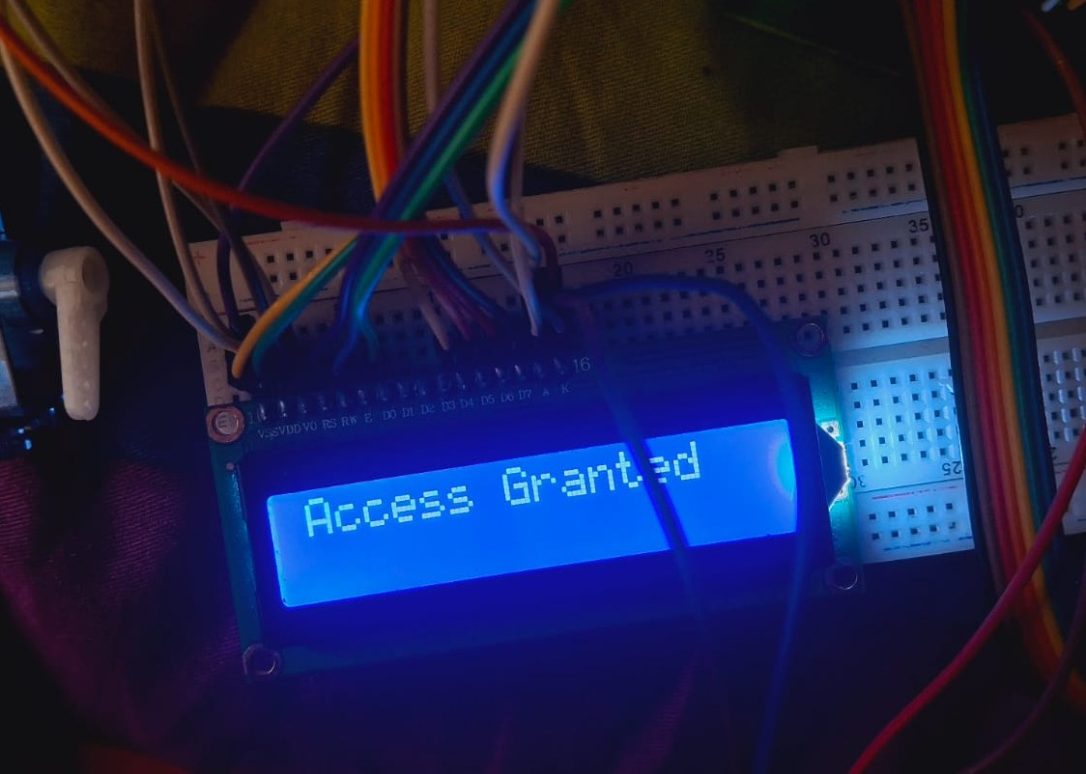
11
Fig C3 : After that, will have to enter the password,and once the password is entered, it will show an "Access Granted" message.
Fig C4 : After access is granted, it will show me a "SafeZoneIsYours" message, and through this, we will be able to access our project.
IIUC | 2025

Slide 13
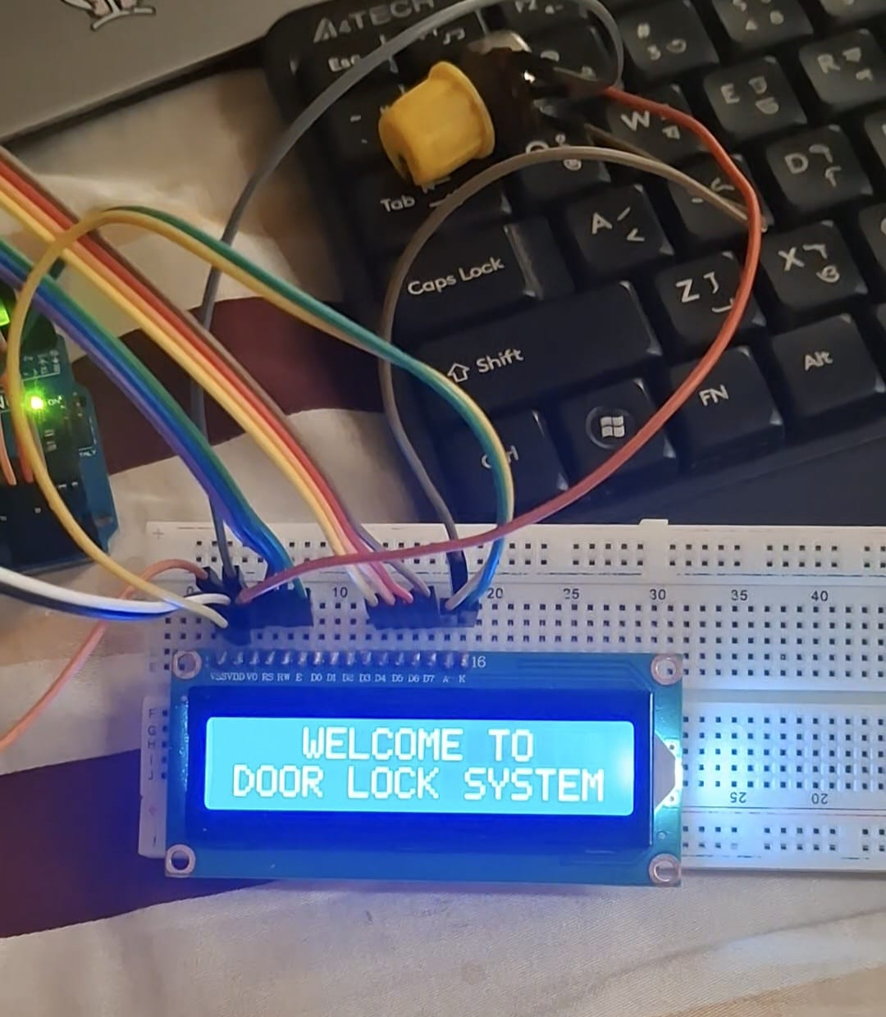
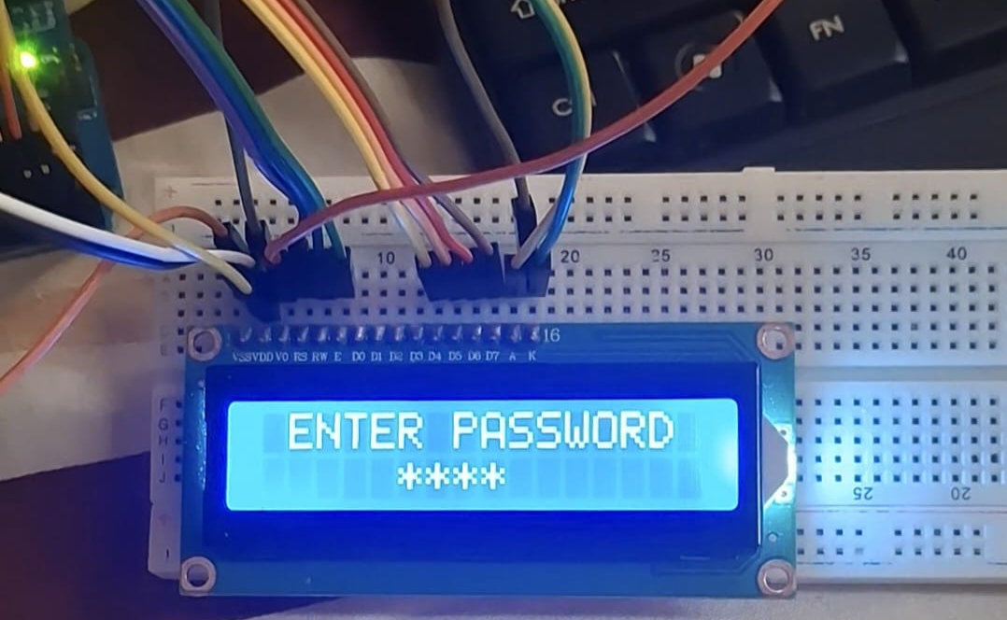
12
Fig C5 : Picture of the “DOOR LOCK” feature
Fig C6 : To unlock the DOOR, the message, “ENTER PASSWORD” will appear, and then will need to enter the password
IIUC | 2025

Slide 14
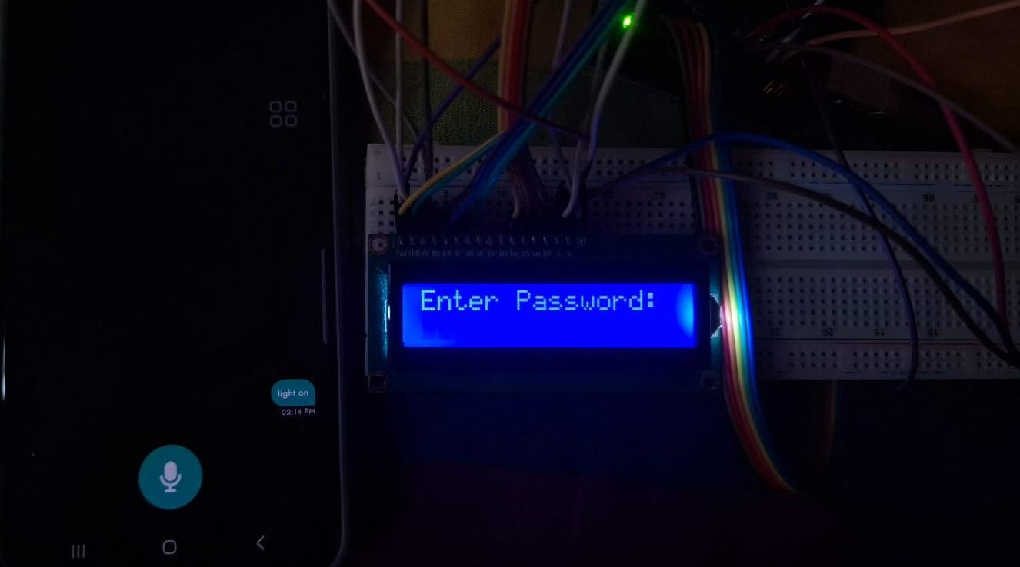
13
Fig C7 : After entering the correct password and access is granted, the direction of the SERVO MOTOR will change, meaning the door Will open
Fig C8 : This is our voice control feature, where after entering the password Will be able to use “voice commands” to turn off the lights and fan
IIUC | 2025

Slide 15
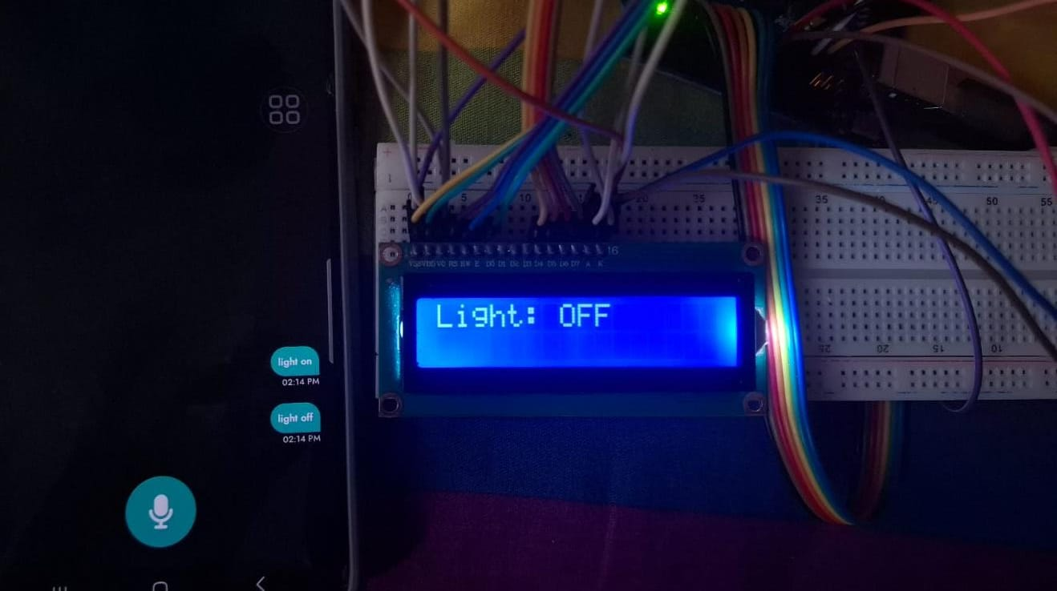
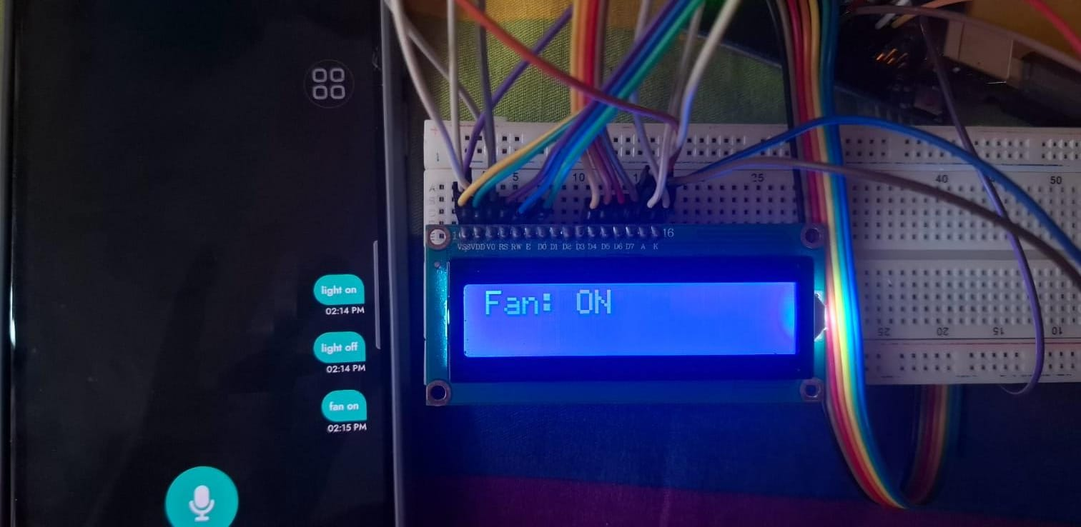
14
Fig C9 : “Voice Commands” for LIGHT & FAN
IIUC | 2025

Slide 16
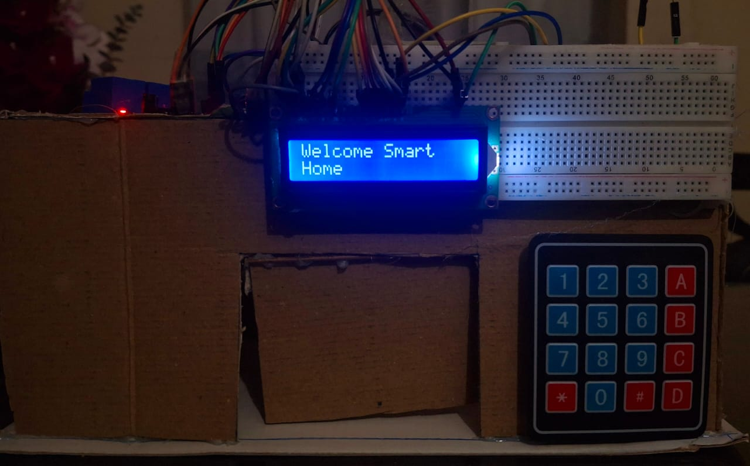
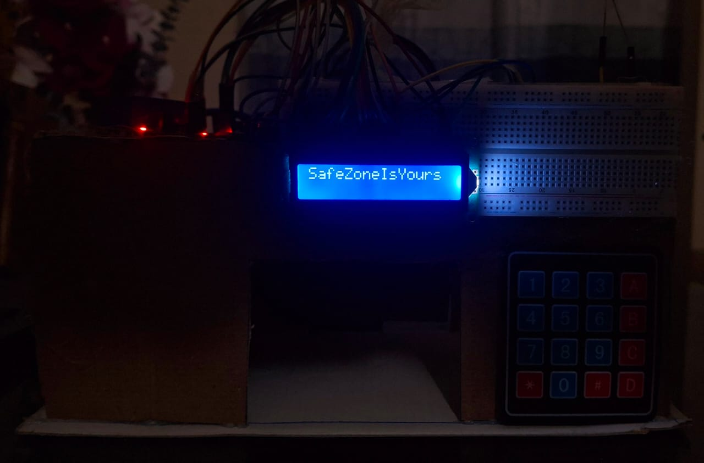
15
Fig C8 : FINAL OVERVIEW of our project
IIUC | 2025

Slide 17
16
RESULT & TESTING
Accurate and Fast Response
Door unlock: ~1s
Appliance control: ~1s
100% correct execution for valid inputs
IIUC | 2025

Slide 18
17
BENEFITS & APPLICATIONS
🏠 Real-Life Value:
Affordable security & automation
Ideal for elderly & mobility-impaired
Educational platform for IoT & Embedded Systems
📈 Scalable:
Add Wi-Fi, sensors, biometrics, mobile apps in future
IIUC | 2025

Slide 19
18
CONCLUSION
Successfully integrated door access + appliance automation
Demonstrates power of embedded tech + wireless control
Bridges learning with practical implementation
Ready for future smart home upgrades
IIUC | 2025

Slide 20
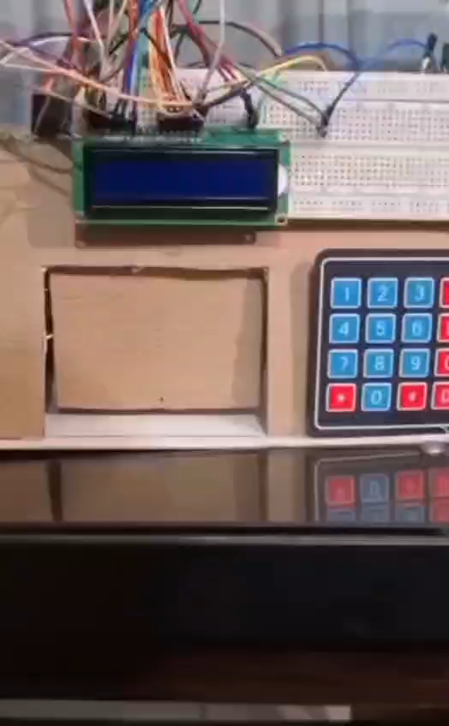
19
PROJECT VIDEO
IIUC | 2025

Slide 21
THANK YOU !
For your attention

